Slide 1


Slide 2
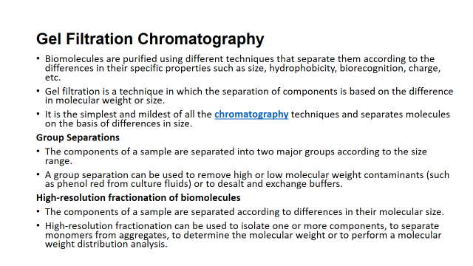

Slide 3
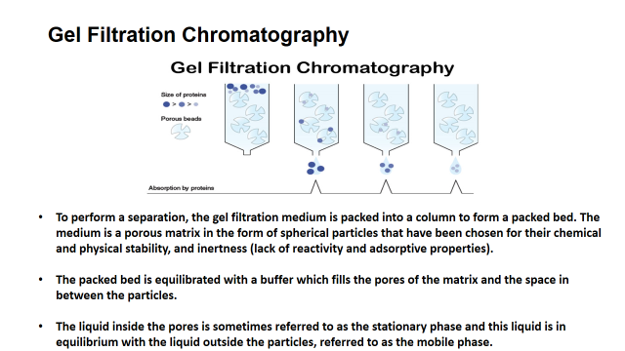

Slide 4
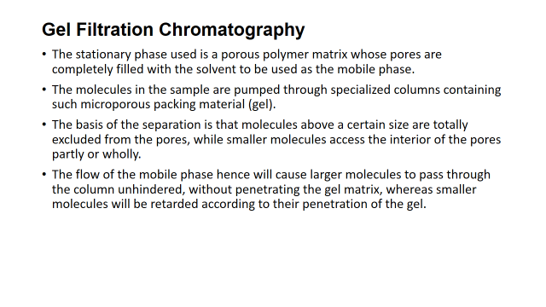

Slide 5
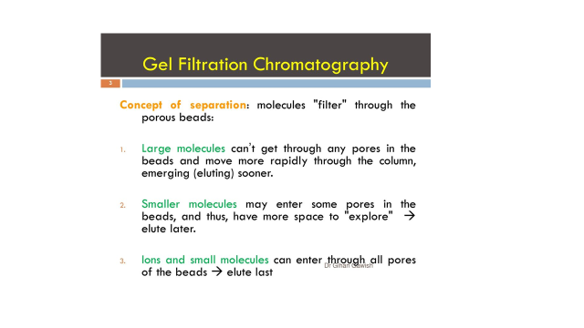

Slide 6


Slide 7
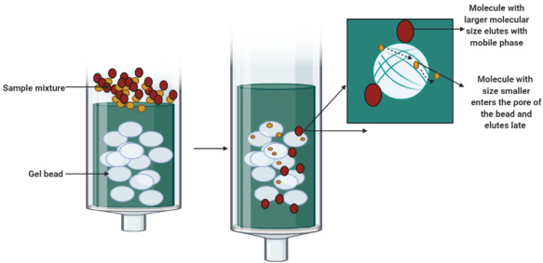

Slide 8
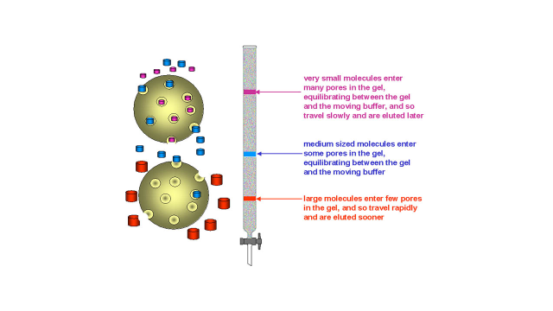

Slide 9
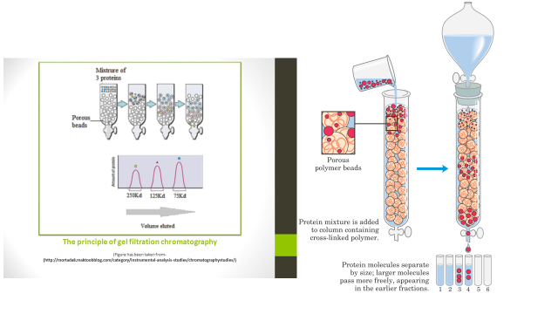

Slide 10
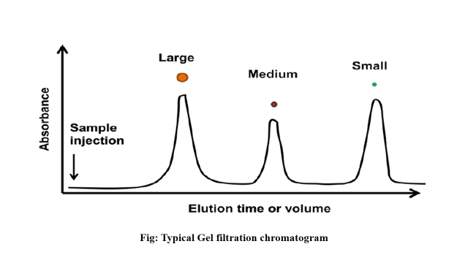

Slide 11
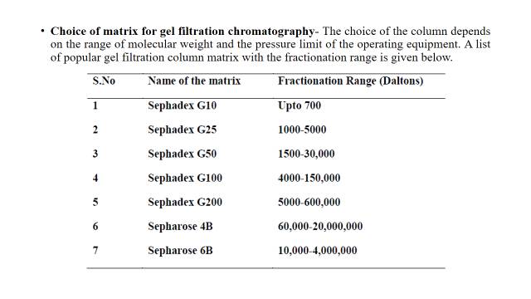

Slide 12
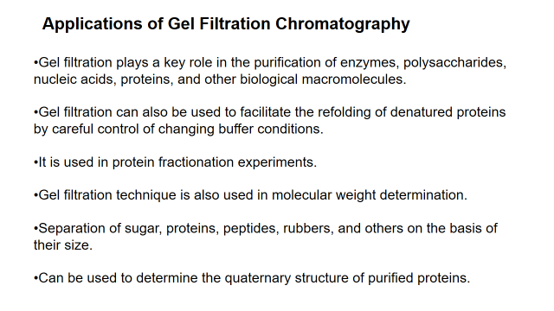

Slide 13
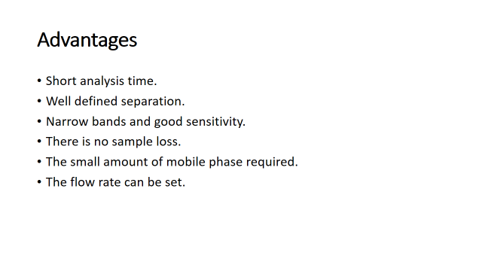

Slide 14
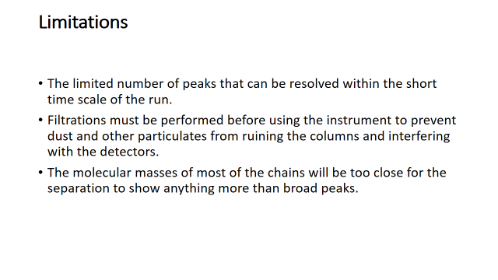

Slide 15
Procedure:
1. Fix the column vertically to a column stand. Allow the column to come to room temperature.
2. Add 4 ml of Gel Filtration Buffer to the column and allow it to drain out completely. This is done for the equilibration of the column.
3. Load 0.2 ml of ready-to-use sample onto the column very carefully.
4. Add 0.2 ml of Gel Filtration Buffer after the sample sinks completely.
5. Allow the Gel Filtration Buffer to drain out completely.
6. Add additional Gel Filtration Buffer to the column till all the coloured biomolecules are eluted out.
7. Use different tubes for collection of the coloured fractions.
8. Store the column at 2-8oC for next use after fixing the top and bottom caps

Slide 16
The gel matrix of the column is Sephadex G-25 which has the capacity to separate molecules with molecular weights from 1000 to 5000 Da.
The ready to use sample containes 3 proteins:
The blue coloured component is blue dextran which has a molecular weight of 2000 kDa. For this reason it can’t enter the beads and elutes first.
The pink coloured component is vitamin B12 which has a molecular weight of 1357 Da. These molecules enter the pores but have a shorter retention period and collected as a second fraction.
The yellow coloured component is Paranitrophenol which has a molecular weight of 139 Da. For this reason they enter the pores of the beads and retain in the gel for a longer period of time and elutes as the last fraction.

